Slide 1

Capstone Project -1
EDA ON HOTEL BOOKING ANALYSIS
Individual Project :
Shubham Naktode
shubhamnaktode30@gmail.com

Slide 2
Problem statement :
For this project we will be analyzing Hotel booking data. This data set contain booking information for a city hotel and a resort hotel. It includes information such as booking ratio of resort hotel and city hotel , length of stay , how many booking cancelled and how long the guest stay.
Hotel industry is a very volatile industry and the booking depend upon the above factor and many more.
The main objective behind this project to explore and analyze data to discover important factors that govern the booking and give insights to hotel management, which can perform various campaigns to boost the business and performance.

Slide 3
Work Flow :
Work flow divide into following four steps.
Data collection and understanding
Data cleaning and manipulation
Exploratory data analysis(EDA)

Slide 4
Data Description :
In this dataset, we have different types of columns. Here we have total 32 columns. In this slide we will discuss about some of important columns in this dataset.
hotel : Two type of hotels (City hotels and Resort hotels).
is_canceled : If the booking was cancelled(1) or not (0).
country : country which from guests originated.
lead_time : Number of days that elapsed between the entering date of the booking into the PMS and the arrival date.
arrival_date_year : Year of arrival date
arrival_date_month : Month of arrival date

Slide 5
Data Description :
stays_in_weekend_nights : Number of weekend nights (Saturday or Sunday) the guest stayed or booked to stay at the hotel.
stays_in_week_nights : Number of week nights (Monday to Friday) the guest stayed or booked to stay at the hotel.
distribution_channel : Booking distribution channel. The term “TA” means “Travel Agents” and “TO” means “Tour Operators”.
is_repeated_guest : Value indicating if the booking name was from a repeated guest (1) or not (0).
adr : Average Daily Rate as defined by dividing the sum of all lodging transactions by the total number of staying nights

Slide 6
For Hotel booking analysis :
We have explored the following points while doing the analysis. The following questions are as follows:
1.What is the booking ratio between Resort Hotel and City Hotel ?
2.Which year has most number of bookings ?
3.What is the percentage of booking for each year ?
4.Which hotel has higher bookings cancellation rate ?
5.From which country most guests come ?
6.How Long People Stay in the hotel ?
7.Which was the most booked accommodation type (Single, Couple, Family) ?

Slide 7
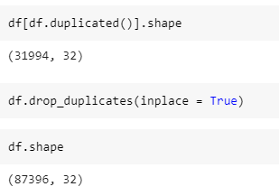
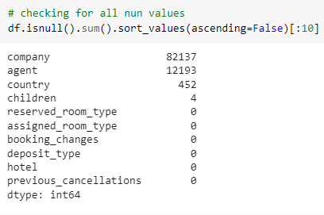
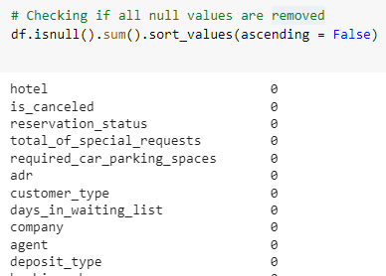
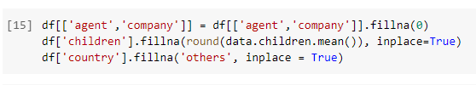
Data cleaning and manipulation :
Handling duplicate , dataset has 31994 duplicate values therefore we drop it from data.
There were 4 columns has missing values.

Slide 8
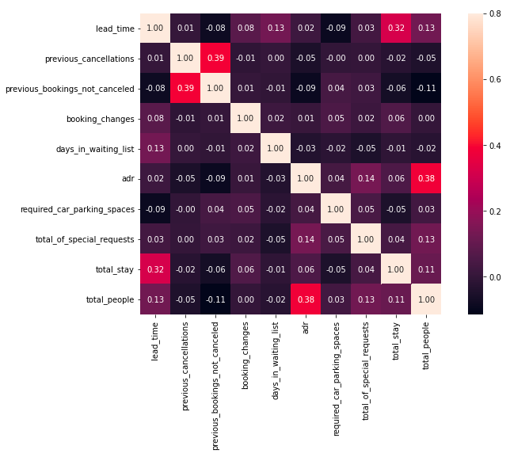
Exploratory Data Analysis (EDA) :
Lets first find the correlation between the numerical data.
1. Total stay length and lead time have slight correlation. This may means that for longer hotel stays people generally plan little before the the actual arrival.
2. adr is slightly correlated with total_people, which makes sense as more no. of people means more revenue, therefore more adr.

Slide 9
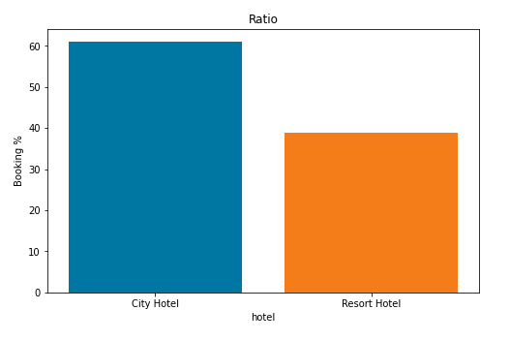
a
1.What is the booking ratio between Resort Hotel and City Hotel ?
From the above pie chart, it seems like most people prefer city hotel type over resort hotel type . So city hotels have demand than resort hotel. The percentage booking of city hotel is more than 60% while the booking of resort hotels around 40%.

Slide 10
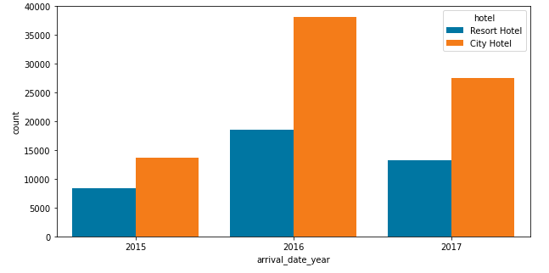
a
2.Which year has most number of bookings ?
In above graph we have 3 year of data 2015-2017. The year 2016 has highest number of bookings done in both the type of hotels. More than double bookings were made in 2016, compared to the previous year. But the bookings decreased by almost 15% the next year.

Slide 11
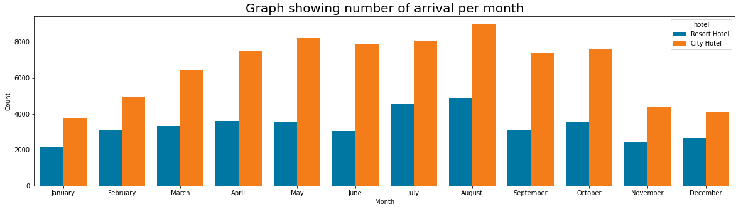
a
3. Which is the busiest month for hotels ?
We can see the trend is kind of similar with a small difference. We also see an increasing trend in booking around the middle of the year with August being the highest arrival. And the starting and ending of year has less number of bookings compare to all the months.

Slide 12
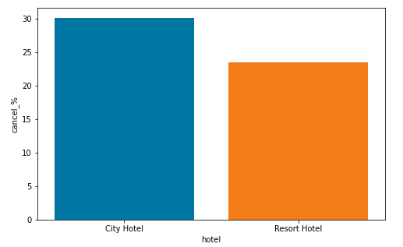
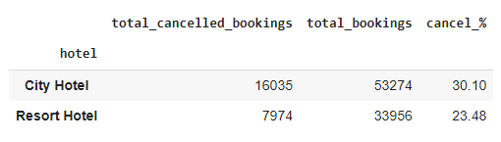
a
4. Which hotel has higher bookings cancellation rate ?
From above graph and data shows that the city hotel has more booking cancelled compare with the resort hotel. City hotels has 30.13% cancellation rate other side resort hotels has 23.48% cancellation rate.

Slide 13
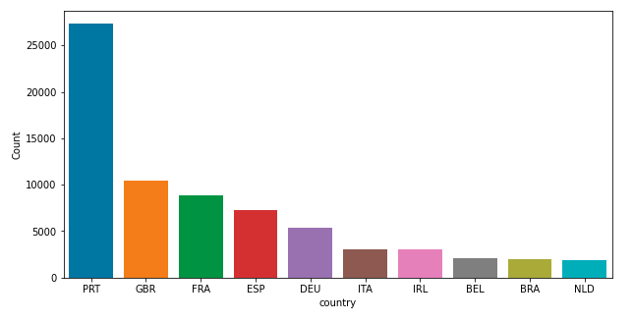
a
5. From which country most guests come ?
From above graph we can conclude that people from Portugal(PRT) is doing maximum number of bookings along side with GBR, France, Spain and so on. More than 80% of bookings come from these 5 countries.

Slide 14
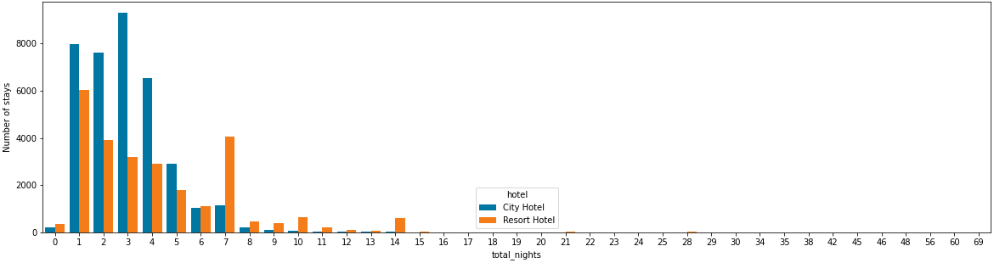
a
6. How Long People Stay in the hotel ?
Above graph shows that the most people prefer to stay at the hotels of <=5 days. But also shown in this graph is that the people who staying in resort hotel has stay maximum number of days than the city hotels.

Slide 15
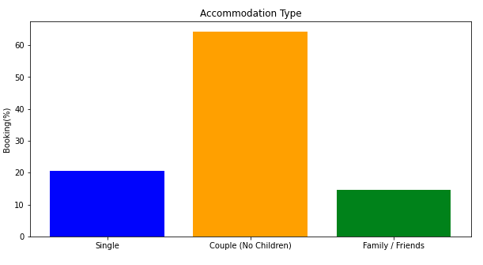
a
7. Which was the most booked accommodation type (Single, Couple, Family) ?
From the above graph, it is clearly seen that the couple (or 2 adults) is the most popular accommodation type. So hotels can make plans accordingly.

Slide 16
Conclusion :
1.More than 60% bookings are for City hotel and around 40% bookings are for Resort hotel.
2.Most bookings were made from July to August. And the least bookings were made at the start and end of the year.
3.More than double bookings were made in 2016, compared to the previous year. But the bookings decreased by almost 15% next year.
4.Almost 35% of bookings were canceled.
5.Portugal, GBR, France, and Spain are the top countries from most guests come, more than 80% come from these 5 countries.
6.Most people stay for one, two, or three.
-> For City hotel, the most popular stay duration is one, two, three and four days respectively.
-> For Resort hotel, most popular stay duration is one, two, three and seven(week), respectively.
7.Couple (or 2 adults) is the most popular accommodation type. So hotels can make arrangement plans accordingly.

Slide 17
Thank You !

